Slide 1
Prerequisites for Therapeutic Studies In Humans & Phase I Trials
Anna Spreafico, MD, PhD
Phase I Bras Drug Development Program
Division of Medical Oncology and Hematology
Princess Margaret Cancer Centre
anna.spreafico@uhn.ca

Slide 2
Disclosurses
Consultant for (Advisory Board): Merck (compensated), Bristol-Myers Squibb (compensated), Alentis (compensated)
Speaker’s Bureau for: None
Grant/Research support from (Clinical Trials): Novartis, Bristol-Myers Squibb, Symphogen AstraZeneca/Medimmune, Merck, Bayer, Surface Oncology, Northern Biologics, Janssen Oncology/Johnson & Johnson, Roche, Regeneron, Alkermes, Array Biopharma/Pfizer, GSK, NuBiyota, Oncorus, Treadwell, Amgen, ALX Oncology, Nubiyota, Genentech, Seagen, Servier, Incyte, Alentis.
Stockholder in: None
Employee of: None

Slide 3
Acknowledgements
Dr. Lillian Siu
Dr. Philippe Bedard
Dr. Albiruni Razak
Princess Margaret Phase I team
Dr. Wendy Parulekar
CCTG team
All of you for your attention

Slide 4
Learning Objectives
To describe the pre-clinical data required to support the development of novel treatments into human trials
To discuss the fundamentals of phase I trial design
To highlight the changes in early phase drug development

Slide 5
Learning Objectives
To describe the pre-clinical data required to support the development of novel treatments into human trials
To discuss the fundamentals of phase I trial design
To highlight the changes in early phase drug development

Slide 6
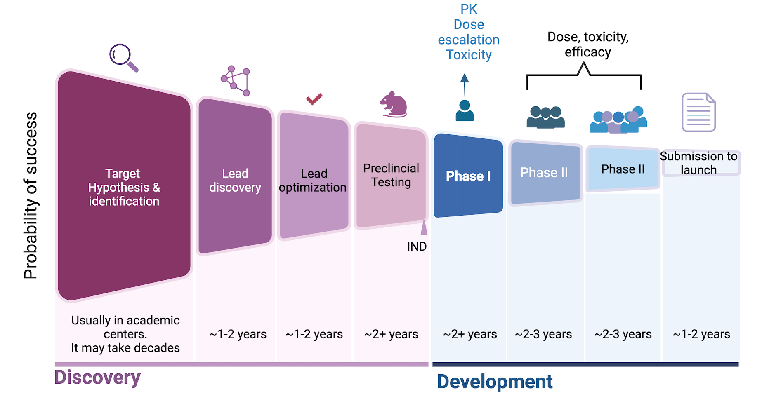
Traditional Drug Discovery & Development path
Adapted from Biorender

Slide 7
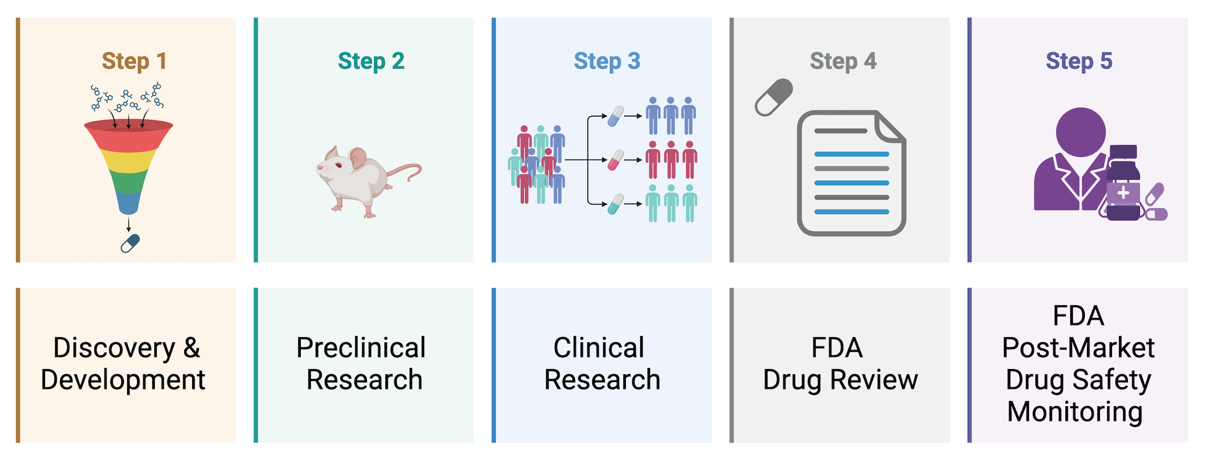
The Drug Development Process
Pre-clincial
Clinical
Target discovery
Compound screening
Lead identification
In vitro studies
In vivo studies
Toxicity testing
Phase I, II, III
Dosage and safety monitoring
Safety and efficacy evaluation
Approval and manufacture
Post release monitoring

Slide 8
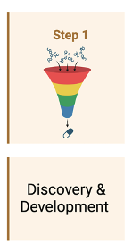
The TARGET Discovery
Learn new insights into a disease process that lead to design a new product to stop or reverse the effects of the disease
Perform lots of tests to find possible beneficial effects
Evaluate expression in clinical specimens
tumor types, prevalence, tissue specificity
All comers vs enriched design
Resistant vs naïve population
Evaluate existing treatments that have unanticipated effects.
Use new technologies that provide new ways to target medical products to manipulate genetic material

Slide 9
The DRUG Development
Learn how it is:
Absorbed (po/IV)
Distributed (tissue concentration, reservoirs)
Metabolized and Excreted (CYP enzymes, metabolites, route of excretion)
Potential benefits and mechanisms of action
Appropriate dosage
The best way to give the drug (such as by mouth or injection)
Side effects
How it affects groups of people (gender, race, or ethnicity) differently
How it interacts with other drugs and treatments
Its effectiveness as compared with similar drugs

Slide 10
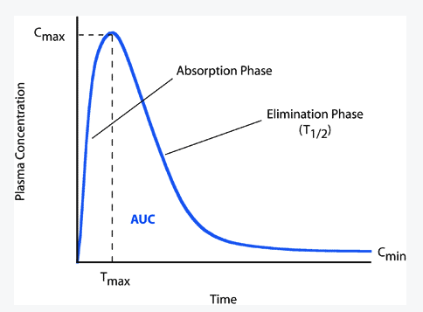
PK Parameters:
describe the absorption, distribution, metabolism, and excretion of drugs in the body.
Pharmacokinetic (PK) Profile
Maximum concentration (C_{max}), Exposure (AUC), ½ life (T_{1/2}), distribution
Accumulation & multiple dose effects
Impact on Trial Design
Route and schedule of administration
PK/PD sampling time points
PK-toxicity associated
PK-efficacy associated
Eligibility Criteria (renal and hepatic function)
Concomitant Medications

Slide 11
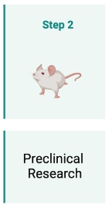
Preclinical Research
2 types:
In Vitro
In Vivo
FDA requires good laboratory practices (GLP). These regulations set the minimum basic requirements for:
study conduct
personnel and facilities
equipment
written protocols and operating procedures
study reports
a system of quality assurance oversight for each study to help assure the safety of FDA-regulated product
These studies must provide detailed information on dosing and toxicity levels.
After preclinical testing, researchers review whether the drug should be tested in people.

Slide 12
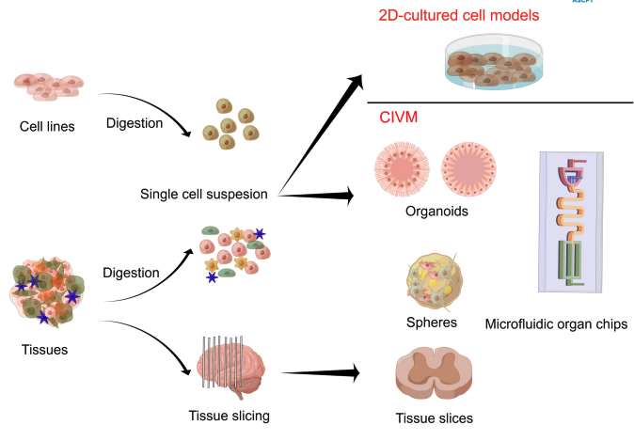
In Vitro Models
2-D cultured cell models
primarily involve research platforms based on cultured cells, typically in the form of two-dimensional (2D) cell models.
Complex In Vitro Models
seek to reconstruct the organ- or tissue-specific characteristics of the extracellular microenvironment.
Modified from Wang et al. Clin Transl Sci. 2024
Other models:
Genetically engineered mouse models (GEMMs)
Chemically induced tumor models
Syngeneic or xenogenic tumors or cells implanted subcutaneously or orthotopically

Slide 13
In Vivo Toxicology Studies: Objectives and types
To identify an initial safe dose and subsequent dose escalation schemes in humans
To identify safety parameters for clinical monitoring.
To identify potential target organs for toxicity whether such toxicity is reversible;
Species
Few animal organ specific toxicities predict for human toxicities:
Myelosuppression and gastrointestinal toxicity more predictable
Hepatic and renal toxicities –large false positive

Slide 14
First in Humans Dose Nomenclature
Acronym | Definition | Explanation
MRSD | Maximum recommended starting dose
NOAEL | No observed adverse effect level | The highest dose level that does not produce a significant increase in AEs
NOEL | No observed effect level | Refers to any effect, not just AE
LOAEL | Lowest observed adverse effect level | Lowest observed dose that lead to AE
HED | Human equivalent dose | The quantity of a chemical that, when delivered in humans, produces an effect = to the one in test animals by a smaller dose
LD10 | Lethal dose 10 | Dose that is lethal in 10% of animals
MABEL | Minimal anticipated biological effect levels | The lowest dose that is associated with any biological effect, either toxicity or a desired pharmacological effect

Slide 15
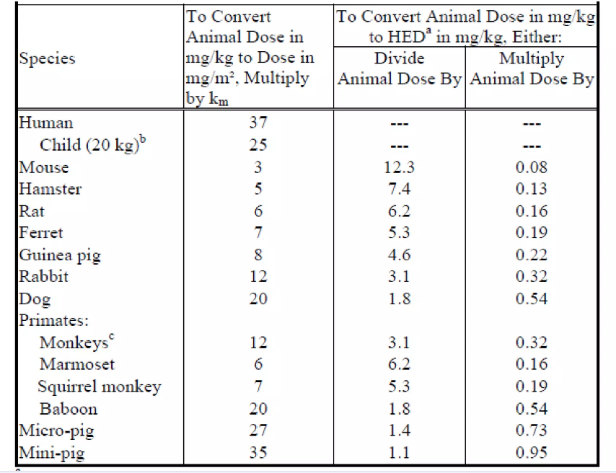
Starting dose selection steps
Conversion of animal doses to human equivalent doses based on body surface area
Step 1
NOAEL: generally a benchmark for safety when derived from appropriate animal studies
Both statistically and clinically significant AEs should be considered in determining NOAEL
Step 2
NOAELs in relevant animal studies are converted in HEDs with appropriate scaling factors
Assumption: LD10 and MTDs in non-rodents both correlate with Human MTD when the doses are normalized to the same administration schedule and expressed as mg/m²
Step 3
HED should be chosen from most appropriate species (most sensitives)
Factors that could influence the choice of species: differences in absorption, distribution, metabolism, excretion

Slide 16
Role of Biomarkers
Impact on Trial Design
Provide proof of mechanism/concept
Select patients
Tissue vs
“surrogate tissue”
Implement in escalation vs expansion only
Increases complexity and cost
Limits pt numbers

Slide 17
Learning Objectives
To describe the pre-clinical data required to support the development of novel treatments into human trials
To discuss the fundamentals of phase I trial design
To highlight the changes in early phase drug development

Slide 18
Phase I Pillars
Objectives
Eligibility
CTCAE
DLT
RP2D
TOXICITY
ESCALATION METHODS

Slide 19
Phase I Objectives
Primary
DLT
RP2D
Secondary
Describe Toxicity
PK
PD
antitumor activity

Slide 20
Patient Population Criteria
Conventional Eligibility | Agent-Specific Eligibility
Advanced solid tumors unresponsive to standard therapies or for which there is no known effective treatment | Specific organ exclusion Cardiac function (e.g. QTc≥450-470 ms, LVEF ≤ 50%, etc), acute MI/CVA if preclinical cardiac risk Recent hemorrhage or ongoing anticoagulation for agents with bleeding risk (ie. antiangiogenic) Diabetes or fasting plasma hyperglycemia ≥ 7.0 mmol/L for agents with risk of hyperglycemia(ie. PI3K/AKT)
ECOG PS 0-1
Adequate organ function
N of prior lines of therapy
Pre-determined wash out period | Prohibited concurrent medication or autoimmune disorders (for IO)
No serious/uncontrolled medical conditions | Prior exposure to same class of agent

Slide 21
Common Terminology Criteria for Adverse Events CTCAE
G1= Mild
G2=Moderate
G3=Severe
G4=Life-threatening
G5=Fatal
NOTE: Important to define attribution to the IP

Slide 22
Dose Limiting Toxicity DLT
Toxicity that is considered unacceptable (due to severity and/or irreversibility) and limits further dose escalation
Specified using standardized grading criteria (ie. CTCAE)
Typically defined based on toxicity seen in the first cycle (DLT period)
DLT is defined in advance prior to beginning the trial and is protocol-specific

Slide 23
Consideration for DLT
INTERMITTENT dosing
High threshold for DLT because the interval between treatments allows for rest and recovery
Examples:
Grade ≥ 3 non-hematologic toxicity despite supportive measures
ANC < 0.5 x 10⁹/L for > 5 or 7 days
Febrile neutropenia (ANC < 1 x 10⁹/L, fever > 38.5ºC)
Platelets < 25 x 10⁹/L or thrombocytopenic bleeding
Inability to re-treat patient within 2 weeks of scheduled treatment
CONTINUOUS dosing
Lower threshold for DLT
Some Grade 2 toxicities may be unacceptable and intolerable due to their persistence and lack of time/period for recovery
Examples:
Grade 2 intolerable or worse non-hematologic toxicity despite supportive measures
Recurrent Grade 2 intolerable toxicity after interruption
Grade 3 or worse hematologic toxicity
Inability to complete a pre-specified percentage of treatment during the cycle due to toxicity (e.g. missing 20-25% of doses)

Slide 24
Recommended Phase 2 Dose RP2D
The dose of a drug or drug combination that was identified in a Phase 1 study (dose finding study) and selected for continued study in future clinical trials.

Slide 25
Dose Escalation Methods: Ruled-Based
Type | Methods | Advantages | Disadvantages
Rule-based | 3+3 | Easy to implement No special software required Provide some data on PK intra-patient variability | Subtherapeutic dose Slow escalation Uncertainty about RP2D Only current dose data used to determine dose of next cohort
 | ATD: Accelerated titrated design | Faster escalation Risk of more pts exposed to higher doses Data from all pts, cumulative tox and intra-pt variability can be fit to a model to establish RP2D | Difficult interpretation of data when intra-pt dose escalation is allowed as may mask cumulative or delayed dose Uncertainty about RP2D
 | Pharmacologically guided | Faster escalation PK data inter-pt variability | Need real-time PK results Inter-pt variability may hamper dose escalation
Other ruled-based deigns exist
Modified from Le Tourneau, et al. JNCI 2009

Slide 26
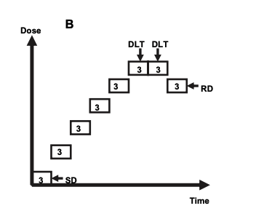
Ruled-based: Traditional 3+3 Design
Challenges
Wide confidence intervals around RP2D
Low drug exposure in early dosing cohorts
High risk of overdosing in later cohorts
Potential long dose escalation phase
MTD
Modified from Le Tourneau, et al. JNCI 2009

Slide 27
Ruled-based: Accelerated Titration Design
DLT
3 pts
+
3 pts
DLT
3 pts
3 pts
Recommended dose
Dose
Gr 2 toxicity
1 pt
1 pt
1 pt
Starting dose

Slide 28
Dose Escalation Methods: Model-based & assisted
Type | Methods | Advantages | Disadvantages
Model-based | CRM: Continual reassessment methods, modified CRM EWOC: Escalation with overdose control Time to event continual reassessment model, effTox, TriCRM BLRM: Bayesian logistic regression model | Defined target toxicity level Rapid dose escalaltion Considers data from all pts More precise MTD estimate Take into account later toxicity Take into account both toxicity and efficacy | Need to have a prior guess of the RP2D Computations after each pt or cohort of pts. Requires biostatistical support and a parametric model for dose-toxicity curve, which is then updated with accumulating data Can expose pts to unacceptably high/toxic doses if the pre-specified model is incorrect
Model-assisted | Modified toxicity probability interval (mTPI) or mTPI-2 Keyboard Bayesian optimal interval design (BOIN) | Combines both superior performance and simplicity of rule-based and model-based frameworks.
Modified from Le Tourneau, et al. JNCI 2009

Slide 29
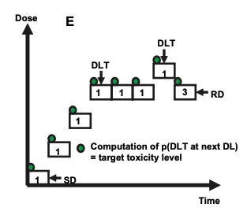
Model-based: Modified continual reassessment method
CRM: assumes a parametric function between dose and toxicity probability by updating the observed data from each patient treated on study. The dose with the updated toxicity probability closest to the target rate is assigned to the next cohort of pts.
Target toxicity level: The maximum probability of DLT that is considered acceptable in the trial. In phase I trials, it is typically between 20% and 33%.
Modified from Le Tourneau, et al, JNCI 2009

Slide 30
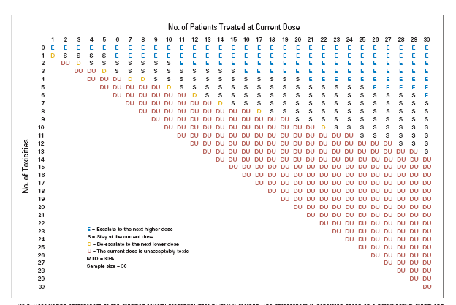
Modified Toxicity Probability Interval (mTPI) Design: A Model-Assist Design
Ji Y and Wang S-Y. J Clin Oncol 31: 1785-1791, 2013

Slide 31
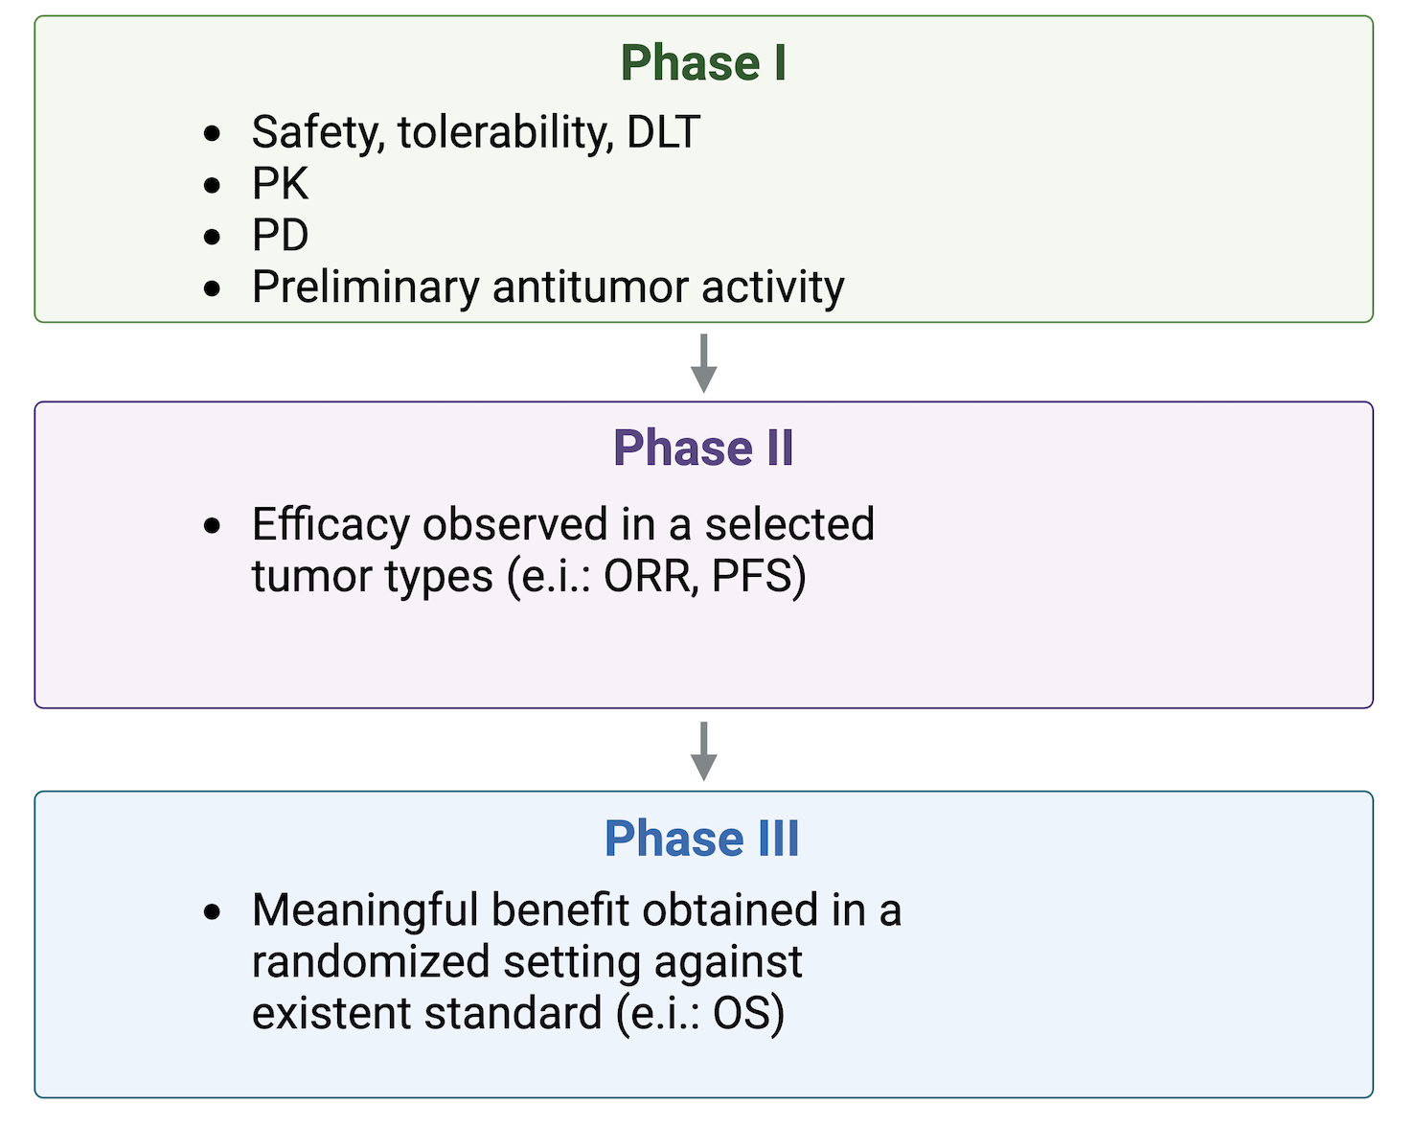
The Traditional Drug Development Paradigm

Slide 32
Example of Traditional Phase I Study Design
Unselected Patients in Dose Escalation
Small Expansion Cohort to Refine RP2D
Dose Escalation | Cohort Expansion
DL1
DL2
DL3
RP2D
AIMS:
Refine Recommended Phase II Dose (RP2D)
PK, PD evaluations in a more homogeneous group
Preliminary antitumor activity
AIMS
Safety/dose limiting toxicities
PK, PD
Define MTD/RP2D

Slide 33
Learning Objectives
To describe the pre-clinical data required to support the development of novel treatments into human trials
To discuss the fundamentals of phase I trial design
To highlight the changes in early phase drug development

Slide 34
Why Are Phase I Trials Changing?
Increased Knowledge of molecular biology
Patient & infrastructure resources are limited
Rapidly advancing technology
Bring more active compounds in clinic
Accelerated regulatory approval for compelling results

Slide 35
SCIENTIFIC Aspects Comparison of Past and Present Ph I Trials
Characteristic | Past | Present
Preclinical work to select lead candidates | Limited number of cell line models | More realistic models such as patient-derived xenografts (PDX)
Preclinical PK-PD explorations to predict biologically relevant concentration in patients | Some | Detailed
Human starting dose | Standard methods e.g. LD10, MABEL | Continue to use standard methods in most cases
Selection of patients | Often unselected | Selection by histology, mutational profile, prior IO exposure, etc
Dose escalation methods | Rule-based designs dominate | Increasing use of model-based or model-assisted designs
Go-no-go decisions | Safety, PK-PD data | Safety, PK-PD data, and increasing reliance on signals of clinical activity
Learning from other agents with same or similar mechanism of action (MOA) | Limited | Increased but still limited by minimal data sharing
Courtesy of Dr Siu

Slide 36
OPERATIONAL Aspects Comparison of Past and Present Ph I Trials
Characteristic | Past | Present
Number of patients | 20-40 | 100s-1000s
Expansion cohorts | 1-2 with <20 pts each | Multiple with ++ pts
Number of participating sites | 2-3 | 20-50+
Geographic locations | North America and Europe dominant | Globalization
How is knowledge gathered | Investigator-centric: Expert observation and pattern recognition by a few phase I oncologists and their teams | Sponsors/CRO-centric: These entities manage database and investigators share observation of limited numbers of patients on teleconferences
Complexity | ++ | ++++
Courtesy of Dr Siu

Slide 37
Economics and Logistics of Phase I Trials
Sites must open more trials to stay financially viable
Increased regulatory burden (protocol amendments, SUSARs, etc)
Trials remain open for long time (need to follow up for late toxicity or survival)
Cost per case is increased
Less investigator experience per trial
Sponsor must collect & share trial safety data with investigators on a regular basis
Overall sample size
Number of sites
Trial complexity
Trial duration
Costs to conduct the trials
Recruitment per site

Slide 38
Factors to Consider for Recommended Dose Decisions
Drug | Drug class Mechanism of action (MOA)
Patient Population | Histology selection Biomarker selection
Toxicity | DLT Chronic toxicity requiring dose interruptions
PK | Dose-PK effect relationships Biologically relevant concentration
PD | Target engagement Proof-of-mechanism vs proof-of-concept
Clinical Activity | Objective response or prolonged stabilization in progressing pts

Slide 39
Dose-Effect Curves differ for cytotoxics vs MTA vs IO
1.0
1.0
1.0
CT Toxicity
MTA Toxicity
0.8
0.8
0.8
Probability of Effect
MTA Efficacy
CT Efficacy
Probability of Effect
Probability of Effect
0.6
0.6
IO-Efficacy
0.6
0.4
0.4
0.4
0.2
0.2
IO-Toxicity
0.2
0
0
0
Dose
Dose
Dose
sigmoidal curve: higher the dose, higher the effect and higher the toxicity, unless a plateau is reached.
Therapeutic window can be narrow
efficacy can be observed at lower doses where toxicities may be more tolerable, thus there may not be any need to go to the highest dose. Therapeutic window can be wider

Slide 40
Project OPTIMUS
Launched in 2021 by FDA Oncology Center of Excellence
Reform the dose optimization and dose selection paradigm in oncology drug development
Communicate expectations for dose-finding and dose optimization, through Guidance, workshops, other public meetings
Provide opportunities for and encourage drug developers to meet with FDA Oncology Review Divisions early, well before conducting trials intended for registration, to discuss dose-finding and dose optimization.
Develop strategies for dose finding and dose optimization that leverages non-clinical and clinical data in dose selection, including randomized evaluations of a range of doses in trials. Perform these studies as early and efficiently as possible in the development program to bring promising new therapies to patients.

Slide 41
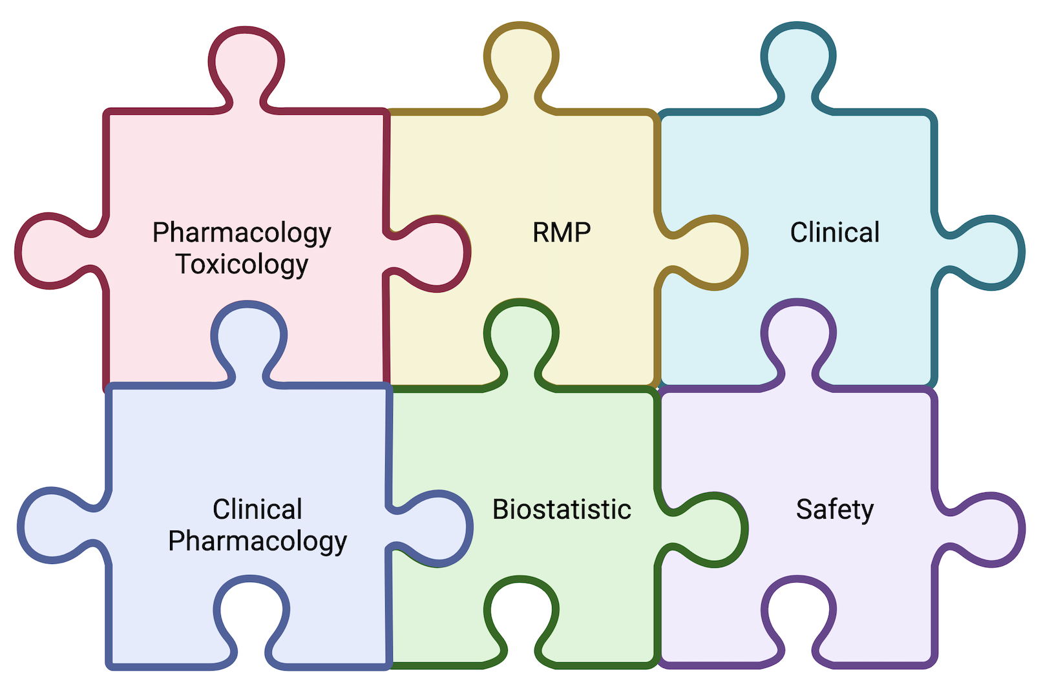
Project OPTIMUS Multidisciplinary Team
2021 OCE Program & Project Review: Project Optimus
OCE: Rick Pazdur, Marc Theoret
Leads: Atik Rahman, Mirat Shah
RPM: Pam Balcazar
Pharmacology/Toxicology: Haleh Saber, Matthew Thompson
Clinical Pharmacology: Brian Booth, Lanre Okusanya, Stacy Shord
Pharmacometrics: Jiang Liu, Hao Zhu
OCP Policy: Raj Madabushi
Clinical: Brian Heiss, Jennifer Gao, Gwynn Ison, Elizabeth Duke, Shruti Gandhy, Cara Rabik, Pam Seam
Safety: Abhi Nair
Biostatistics: Joyce Cheng, Jonathon Vallejo, Gary Rosner
CBER: Lianne Wu, Xiaofei Wang
Analysts: Alex Akalu, Susan Jenney
Modified from Shord, FDA-AACR Public Workshop, Feb 2024

Slide 42
Consequences of Not Optimizing Dosage Before Approval
Drug is poorly-tolerated at the approved recommended dosage
Patients may stop taking a potentially effective drug
Patients choose to try a different drug
Drug does not make it to market or must be withdrawn from the market
It takes long time to evaluate alternative dosages following approval
Patients may not want to participate in trial if commercially available
Disease area moves on to other treatments
Shord, FDA-AACR Public Workshop, Feb 2024

Slide 43
Holistic approach to evaluate all data to inform dosage selection for clinical trials.
Consider all data
PK, PD, activity/efficacy, safety, and tolerability data at each step
Evaluate safety info beyond DLTs
low-grade symptomatic toxicities, dosage modification frequencies, patient-generated data for treatment-related symptoms
Identify a target dosage range early
then further evaluate several dosages (ideally in a randomized trial)
Characterize dosage and exposure relationship
For efficacy and toxicity
Shord, FDA-AACR Public Workshop, Feb 2024

Slide 44
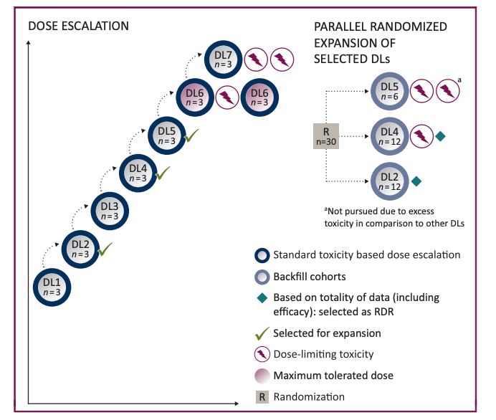
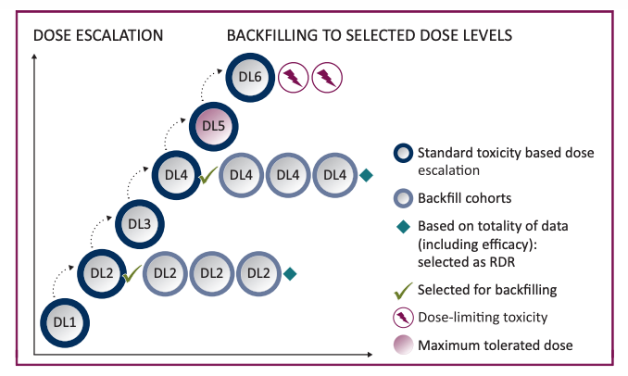
Dose Optimization MDICT 2022 Based on Project Optimus
Araujo DV, Greystoke A, et al Annals Onc 2023
MDICT: Methodology for the Development of Innovative Cancer Therapies

Slide 45
Seamless Trial Design
Phase I-II-III
Dose Optimization
Large randomized cohort against standard of care
or
Single arm expansion in large cohort (for rare molecular or tumor types)
Dose Finding:
Biomarker or histological selection
PK, PD, efficacy
Dose Expansion
Small randomized cohorts in limited indications

Slide 46
Integrated early trial design
Mitigate risks by systematically removing uncertainties
Ph1
Ph2
Ph3
1. Dose Escalation; Collect safety, efficacy, PK, PD
3. Stand-alone Phase 3 or Seamless Ph2/3 design to further confirm
2. Randomized dose finding ( ≥2 dose levels in a range) as dose expansion or Phase 2 trial
Cohort A1 (Randomized)
Enroll Stage 2 patients at RP2D
Dose 6
Select
RP2D
Dosage level 2
Potential to expand cohort(s) for accelerated approval
Dose 5
Cohort A2
Dose 4
Dosage level 1
Stage 2 Decision
RP2D
Stage 1 Decision
BTD
Dose 3
Initiate additional cohorts after identification of RP2D (basket design)
SOC
Dose 2
Dose 1
Cohort B1
Cohort B2
Cohort C1
Cohort C2
MIDD: Starting dose, dose escalation scheme, target dose, maximal dose
Option to backfill up to 10 patients at select dose(s) to support determination of 2 levels for optimization
Expected sample size for Cohort A1: 20-40 per dose level
Stage 2 decision: Simon 2-stage design or BOP2 design with statistical justification of the maximum sample size and stopping rules for lack of efficacy
Stage 1 Decision: futility + criteria for selecting RP2D
Sarac, 2024 ESMO TAT Congress
Meet with FDA

Slide 47
Common IO Phase I Study Design
Dose Escalation | Cohort Expansion
 | Pharmacodynamics | Targeted Subgroups
Tumor biopsies for immune biomarker evaluations e.g. TILs
Hot vs cold tumors
IO naïve vs exposed pts
Novel IO agent mono-therapy
Novel IO agent + anti-PD-1/L1 antibody

Slide 48
IO+IO Combinations – Possible Decision Tree
Novel Agent
Yes
Monotherapy dose expansion
Optimal dose + CPI limited dose escalation & dose expansion cohorts (adaptive)
No
How to make go-no-go decision?
Monotherapy dose optimization
Take most likely active indication and perform a small R comparison of novel agent + CPI vs CPI alone
Monotherapy activity

Slide 49
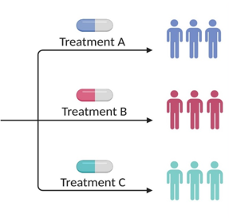
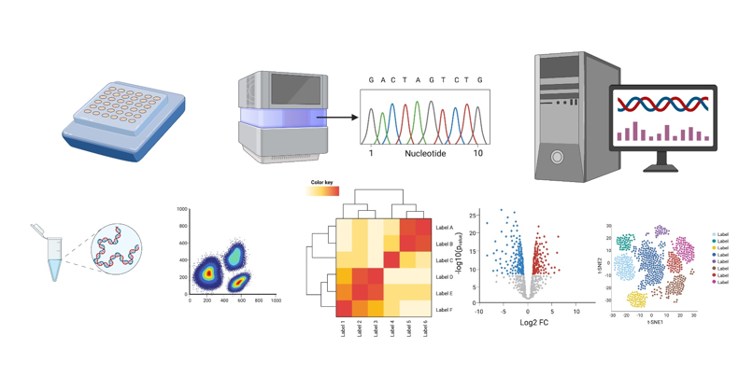
Phase I Trials of the Future:
Patient-Centric, Not Drug-Centric or Trial-Centric
Early read out such as ctDNA dynamics
Deep characterization of exceptional responders and exception progressors
Data sharing and iterative learning from ongoing and completed trials
Multi-omic evaluation including immunprofiling, spatial transcriptomics, functional testing
AI and machine learning models

Slide 50
Take Home Messages
Phase I trials interface between laboratory discoveries and clinical translation
Patient safety/well-being is paramount
Biomarker studies are essential to evaluate new cancer drugs
Phase I trials are evolving to meet the needs of changing landscape in drug development
↑ flexibility, ↓ adherence to traditional rules created in the cytotoxic era
Efforts such as Project Optimus focus on improving go-no-go decisions via:
Maximize clinical, molecular and pharmacological data gained from each patient throughout the trial
Develop innovative design to learn and adapt

Slide 51
Thank you

